Slide 1
Friday, February 1, 2013
Agenda:
TISK & 2 MM
Lesson 12-6 part 2
Homework: Finish 12-6 problems
TISK
Evaluate: $−6+12−18\left(−8+8\right)−7$
Write the equation of a line that passes through the points (7, 9) and (5, -5).
Write and solve a proportion: Seventy is what percent of 40?
Notes:
Mental Math
1.) Start with the largest Fibonacci number that’s less than 100. (89) Subtract the largest perfect square less than 10. (80) Find half of that number. (40) Divide by the number of 15-minute intervals in an hour. (10) Write your answer.
2.) Start with the smallest Fibonacci number that’s greater than 100. (144) Take the square root. (12) Find half of that number. (6) Divide by the number of eggs in a quarter of a dozen. (2) Write your answer.

Slide 2
§12-6 Exponential Functions
What types of situations use exponential functions?
Exponential Growth
Exponential growth is when one amount grows very large, very fast.
Population growth
Cell Phone users from 1990 to now
In exponential growth, the value of a must be greater than 1
Exponential Decay
Exponential decay is when one amount decreases rapidly
Radioactive decay of materials (Half-lives)
Competition brackets
In exponential decay, the value of a must be less than 1.

Slide 3



§12-6 Exponential Functions
A competition starts with 512 teams competing. Every round, two teams play against each other and one is eliminated.
After 3 rounds, how many teams are left?
Exponential Decay!
p = starting amount
p = 512
a = rate of decay
a = $\frac{1}{2}$
x = variable
x = number of rounds
$$f\left(x\right)=512{\left(\frac{1}{2}\right)}^{x}$$
$$f\left(3\right)=512{\left(\frac{1}{2}\right)}^{3}$$
$$f\left(3\right)=512\left(\frac{1}{8}\right)$$
$$f\left(3\right)=64$$

Slide 4

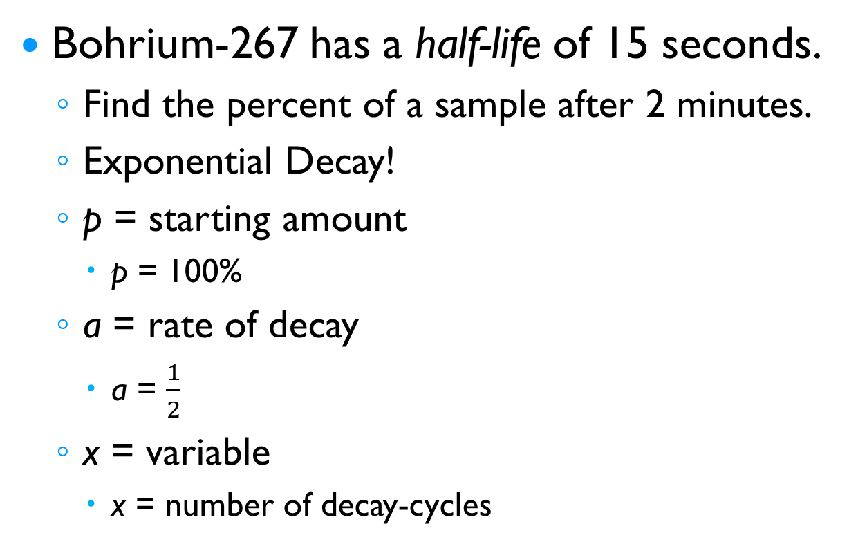

§12-6 Exponential Functions
Bohrium-267 has a half-life of 15 seconds.
Find the percent of a sample after 2 minutes.
Exponential Decay!
p = starting amount
p = 100%
a = rate of decay
a = $\frac{1}{2}$
x = variable
x = number of decay-cycles
$$f\left(x\right)=100\%{\left(\frac{1}{2}\right)}^{x}$$
$$f\left(8\right)=100\%{\left(\frac{1}{2}\right)}^{8}$$
$$f\left(8\right)=100\%\left(\frac{1}{256}\right)$$
$$f\left(8\right)≈.39\%$$

Slide 5
§12-6 Exponential Functions
A bacterial culture contains 5000 bacteria. The number of bacteria quadruples each day.
How many bacteria will be in the culture after a week?
Exponential Growth!
p = starting amount
p = 5,000
a = rate of growth
a = $4$
x = variable
x = number of growth-cycles
$$f\left(x\right)=5000{\left(4\right)}^{x}$$
$$f\left(7\right)=5000{(4)}^{7}$$
$$f\left(7\right)=5000(16384)$$
$$f\left(7\right)=81,920,000$$

Slide 6
§12-6 Exponential Functions
The number of Americans over 100 was about 70,000 in 2000. Say the population of Americans over 100 doubles each decade.
Estimate the population of Americans over 100 in the year 2095.
Exponential Growth!
p = starting amount
p = 70,000
a = rate of growth
a = $2$
x = variable
x = number of growth-cycles
$$f\left(x\right)=70,000{\left(2\right)}^{x}$$
$$f\left(9\right)=70000{(2)}^{9}$$
$$f\left(9\right)=70000(512)$$
$$f\left(9\right)=35,840,000$$
$$f\left(10\right)=70000{(2)}^{10}$$
$$f\left(10\right)=70000(1024)$$
$$f\left(10\right)=71,680,000$$
There would be between 35,840,000 and 71,680,000 Americans over 100 in 2095.

Slide 7


§12-6 Exponential Functions
For each exponential function, find $f\left(−5\right), f\left(0\right),$and $f\left(5\right)$.
$f\left(x\right)={0.3}^{x}$
$f\left(x\right)={10}^{x}$
$$f\left(−5\right)={\left(10\right)}^{−5}$$
$$f\left(−5\right)={\left(0.3\right)}^{−5}$$
$$f\left(−5\right)={\left(\frac{1}{10}\right)}^{5}$$
$$f\left(−5\right)=\left(\frac{10}{3}\right)\left(\frac{10}{3}\right)\left(\frac{10}{3}\right)\left(\frac{10}{3}\right)\left(\frac{10}{3}\right)$$
$$f\left(−5\right)=\frac{1}{100,000}$$
$$f\left(−5\right)=\frac{100,000}{243}$$
$$f\left(0\right)={10}^{0}$$
$$f\left(0\right)={0.3}^{0}$$
$$f\left(0\right)=1$$
$$f\left(0\right)=1$$
$$f\left(5\right)=\frac{243}{100,000}$$
$$f\left(5\right)={10}^{5}$$
$$f\left(5\right)={0.3}^{5}$$
$$f\left(5\right)=100,000$$

